Slide 1
Long Short-Term Memory(LSTM) Model
Mano Krishnan

Slide 2
Introduction to LSTMs
Understanding Sequential Data
What are LSTMs?: Long Short-Term Memory Networks are a type of RNN specialised for sequential data, overcoming the vanishing gradient problem.
Why is it important?:LSTMs enable deep learning models to retain long-term dependencies, crucial for tasks like language modeling and time-series analysis.
Applications:Used in speech recognition, stock price prediction, natural language processing (e.g. chatbots).
Source: https://debuggercafe.com/word-level-text-generation-using-lstm/
Source: https://www.analyticsvidhya.com/blog/2021/03/introduction-to-long-short-term-memory-lstm/

Slide 3
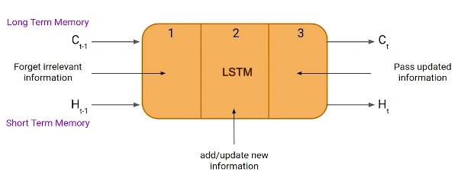
LSTM Architecture
The LSTM architectures involves the memory cell which is controlled by three gates: the input gate, the forget gate, and the output gate.
Forget Gate: Controls what information is removed from the memory cell.
Input Gate: Controls the information added to memory cell.
Output Gate: Controls what information is output from the memory cell.
Image from https://www.analyticsvidhya.com/blog/2021/03/introduction-to-long-short-term-memory-lstm/
Source: https://www.geeksforgeeks.org/deep-learning-introduction-to-long-short-term-memory/

Slide 4
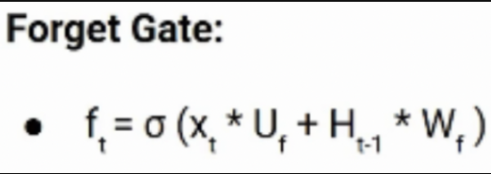
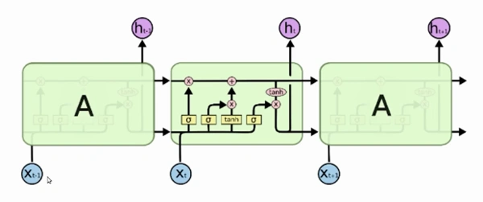
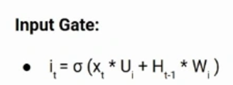
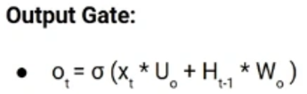
LSTM Working
Roles played by gates in LSTM Architecture
Forget Gate: Decide what information to discard from previous cell state.
Input Gate: Determines which new information is important enough to add the cell state.
Output Gate: Controls what information is passed to the next time step.
Source: https://www.analyticsvidhya.com/blog/2021/03/introduction-to-long-short-term-memory-lstm/

Slide 5
LSTM Example

